Slide 1
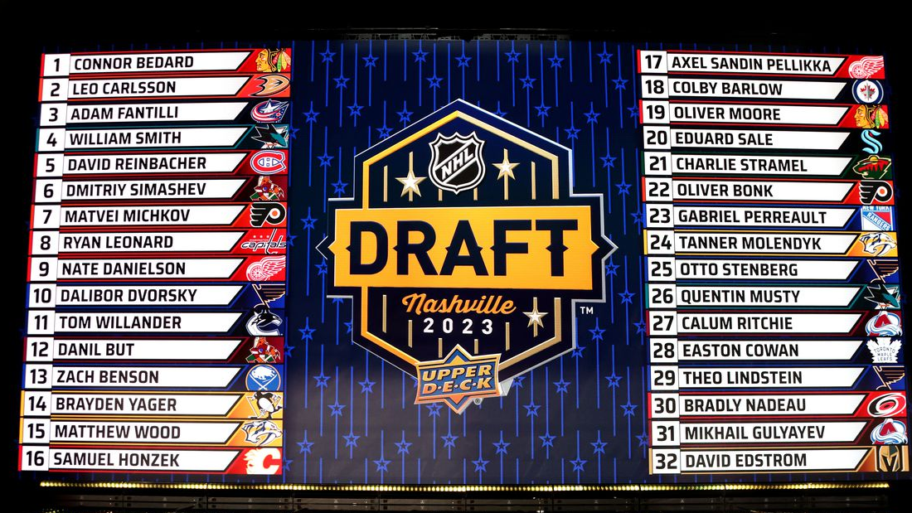
Using Machine Learning to Rank NHL Draft Prospects
Dan Lewitzky
Bryant university
Data Science ‘24

Slide 2


Agenda
Background
Pre-draft Dataset Collected
Preparing Pre-Draft Stats
Final Variables Used in the Model
Results
Custom-Built Predictive Model
Future Enhancements

Slide 3
Background
Majoring in Data Science at Bryant University (‘21-’24); minor in Business Administration
Key courses: multivariate stats, machine learning, database management
Current president of our sports analytics club
Followed hockey in detail for many years
Wanted to create a project combining principal concepts from key courses with my hockey interests
Predicting draft prospects was a perfect fit for this project
Proprietary – Daniel Lewitzky 2023

Slide 4
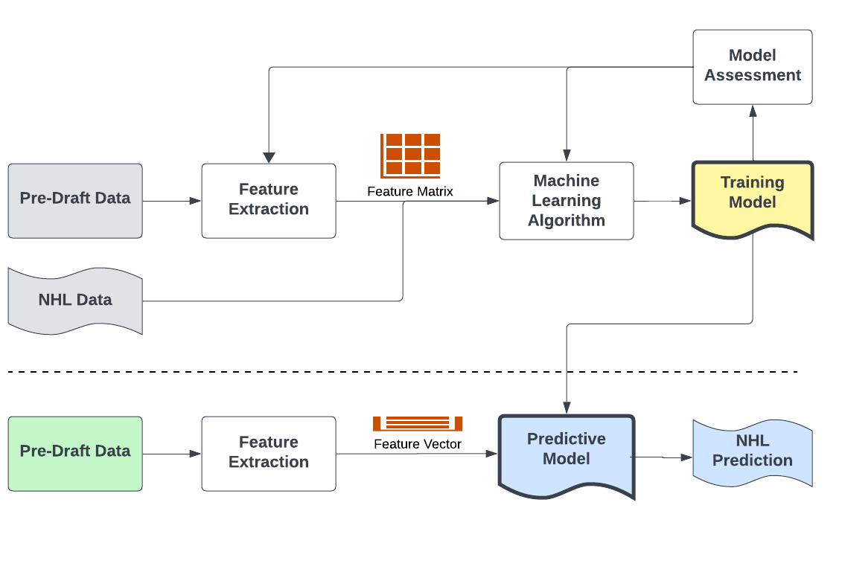
Custom-built predictive model
Training
(Past/Current NHLers)
Predicting
(Upcoming Draft Prospects)
Machine Learning Algorithm Leverages Historical Data to Create Predictions
Proprietary – Daniel Lewitzky 2023

Slide 5
Pre-draft dataset collected
2005-2022 Data From Eliteprospects.com Used For Training Model
Leagues Collected: KHL, VHL, SHL, Liiga, Czechia, NLA, DEL, Allsvenskan, Slovakia, WJC-20, WJC-18, Czech2, NCAA, Mestis, OHL, MHL, USHL, WHL, USDP, QMJHL, J20 Nationell, U20 Sm-Liiga, BCHL, AJHL, USHS-prep.
A Few Prospects Missing Per Year (Did Not Collect Their League)
Created Two Separate Machine Learning Models in Python (Forwards, Defensemen)
Data From Two Most Recent Pre-draft Years Used For Predicting 2015-2023 NHL Drafts
Proprietary – Daniel Lewitzky 2023

Slide 6
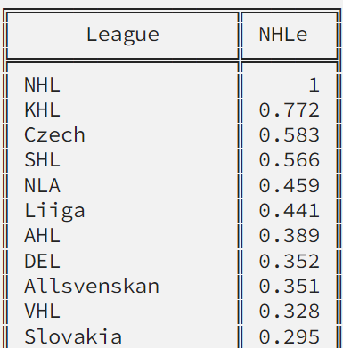
Preparing Pre-draft stats (2 years)
*
NHLe: Points/Game Weighted By How Tough The League Is
Points/Game Were Adjusted For TOI Played For Some Leagues:
KHL, VHL, SHL, Liiga, Hockeyallsvenskan, Czechia
NHL Combine Stats: Top 10 Finishes
Age
NHLe Workflow:
*Patrick Bacon: TopDownHockey
No TOI Adjustment
Calculated proportionally to games played in each league
Pre-draft points/game
Made WJC tournaments worth more
Multiplied by league weight
NHLe
Adjusted for TOI
Proprietary – Daniel Lewitzky 2023

Slide 7
Final Variables/Interactions used in Model
Pre-draft Stats: NHLe (2 pre-draft years), Age, Combine
Combined Both Years Of NHLe:
New NHLe = (NHLeDY0 X 0.8) + (NHLeDYn1 X 0.2)
NHLe * Age
NHLe * Combine
Age * Combine
Final Model Inputs:
Point Shares per game (in the NHL)
Model Predicts
Proprietary – Daniel Lewitzky 2023

Slide 8
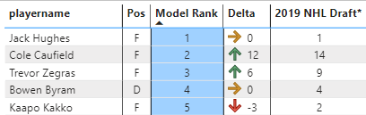
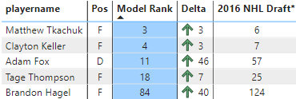


Examples of Results better than NHL draft order
2019:
2016:
2017:
2015:
* Does not include goalies and players whose league I have not collected yet
Key Takeaways:
(NHLe * Age) is key driver
NHL Combine stats have high importance for defensemen
Proprietary – Daniel Lewitzky 2023

Slide 9





Examples of Results worse than NHL draft order
2019:
2016:
2018:
2015:
2017:
Key Takeaways:
Additional defensive stats expected to improve predictions of defensemen
Plan to account for the impact of players switching to a higher league
* Does not include goalies and players whose league I have not collected yet
Proprietary – Daniel Lewitzky 2023

Slide 10
Future Enhancements
Incorporate additional statistical categories for improved predictability
More detailed combine and defensive stats
Powerplay stats, TOI for additional leagues
Improve weights and factors
Calculate my own NHLe weights using a rolling average and directly incorporating TOI
Add Adjustment Factor When Playing In A New/Tougher Pre-Draft League from one year to the next
Add Data From More Leagues (DNL, Swiss U20, Czech U18…)
Continue Work on Goalie Modeling (Less Data Available)
Proprietary – Daniel Lewitzky 2023

Slide 11
Thank you!

Slide 12
Sources
https://www.hockeyslovakia.sk/en/stats/players/843/tipos-extraliga?StatsType=points&PlayerAge=u20
https://www.hokej.cz/tipsport-extraliga/stats-center?season=2011&competition=1133&team=&age=&state=&timeFrom=&yearFrom=&yearTo=&t=f7q4l8jyqem4w4bwtnayoo1u85w557ask4sno2e924jiphcbhj503ei&stats-order=g&stats-direction=desc
https://www.nationalleague.ch/stat/player/toi
https://www.penny-del.org/
https://old.shl.se/statistik/spelare/summary?season=2006&gameType=regular&count=400&position=All&status=All&team=All&vsTeam=All&outcome=all&location=all
https://en.khl.ru/stat/players/185/all/
https://www.puckworlds.com/2010/6/25/1536470/top-source-leagues-for-the-nhl
https://towardsdatascience.com/python-hockey-analytics-tutorial-b0883085938a#aa9e
https://pypi.org/project/TopDownHockey-Scraper/
https://github.com/eoppe1022/elite
NHL Draft Combine Results 2022 (topendsports.com)
https://www.vhlru.ru/en/stats/players/
https://liiga.fi/en/stats/players
https://theleafsnation.com/2017/06/11/nation-network-2017-prospect-profile-15-eeli-tolvanen/?sortby=trash
https://jamesrledoux.com/code/group-by-aggregate-pandas
https://inria.github.io/scikit-learn-mooc/python_scripts/dev_features_importance.html
https://aegis4048.github.io/mutiple_linear_regression_and_visualization_in_python
https://www.medicine.mcgill.ca/epidemiology/joseph/courses/EPIB-621/interaction.pdf
https://statisticsbyjim.com/regression/interaction-effects/
https://stackoverflow.com/
Elite Prospects - Hockey Players, Stats and Transactions
QuantHockey - Complete NHL Stats
NHL Stats, History, Scores, Standings, Playoffs, Schedule & Records | Hockey-Reference.com
https://twitter.com/scottcwheeler/status/1667635148580347907
https://www.simplilearn.com/tutorials/machine-learning-tutorial/regularization-in-machine-learning#:~:text=EdgeJoin%20Cohort-,What%20is%20Regularization%20in%20Machine%20Learning%3F,and%20prevent%20overfitting%20or%20underfitting.
https://www.hockeyallsvenskan.se/
Proprietary – Daniel Lewitzky 2023

Slide 13
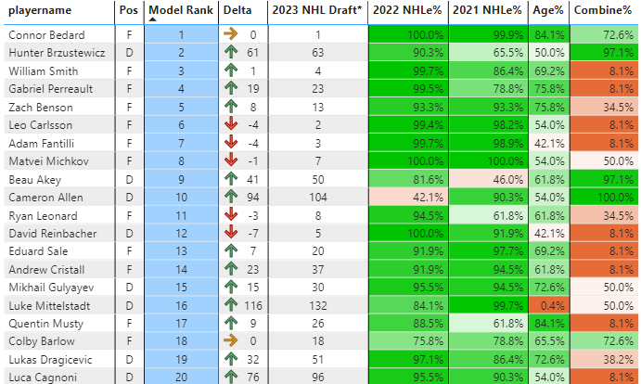
2023 example results
Proprietary – Daniel Lewitzky 2023

